Slide 1
Intro to Web Hacking
Jackie Schultz, RJ Joyce, Grant Spencer

Slide 2
Agenda
Basics
SQL Injection
Cross Site Scripting
Directory Listing and Traversal
Command Injection

Slide 3
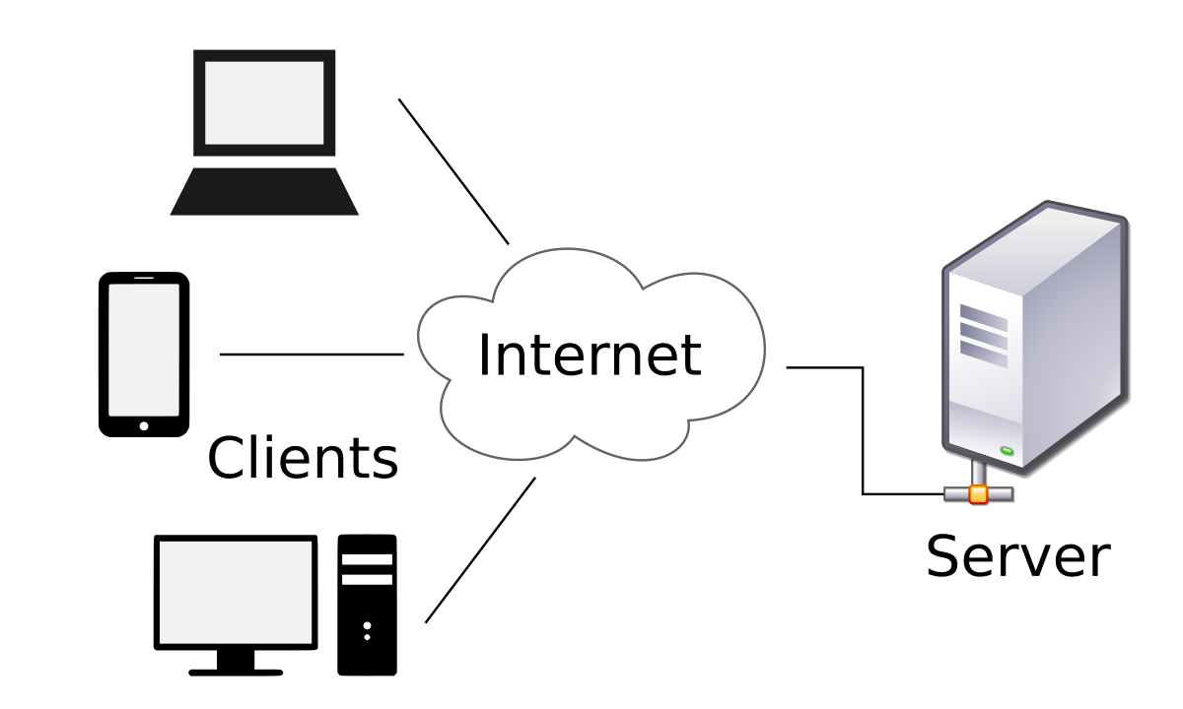
Client-Server Model
Client is a user of some service
Server hosts the service and
fulfills client requests

Slide 4
LAMP Stack
Linux: Operating System
Apache: Web Server
MySQL: Database that stores web server information
PHP: Scripting language for dynamic content

Slide 5
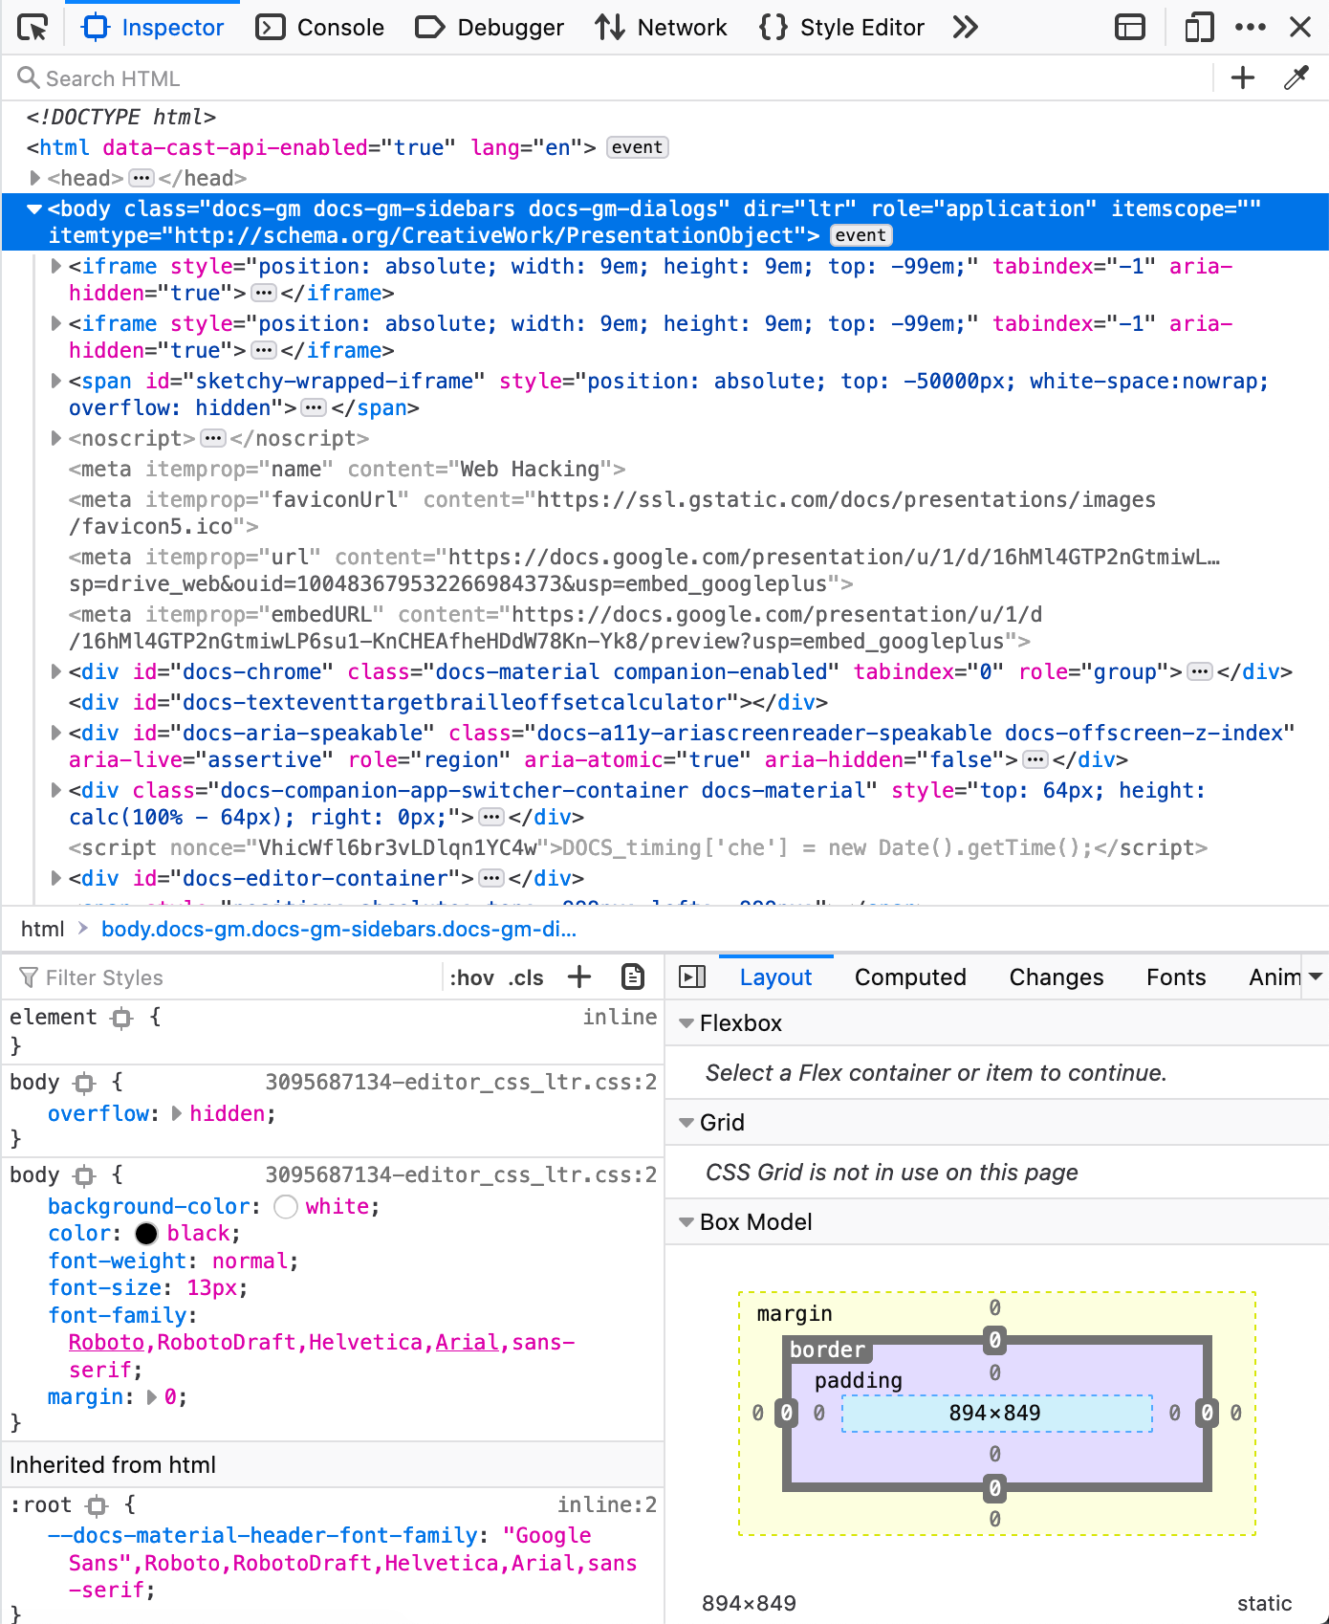
Inspect Element is Your Friend
Tool available in almost every browser
Shows source code of the web page
Also has…
  JavaScript Console that executes in the context of the web page
  JavaScript Debugger
  Network Request manager that allows viewing, editing, and resending
  Cookie Modification
  Tool to track JS API calls all the way back to the backing C library, with nano time
  Other things

Slide 6
SQL Injection
What is SQL?
  “Structured Query Language”
  Family of languages used to interact with a databases
  Exact syntax changes depending upon what database you’re working with
What is SQL Injection?
  Using bad user input to manipulate the SQL query in an unintended way
  Takes advantage of server interpreting user input as code instead of as data
  Tricks an application into sending the database malicious queries

Slide 7
SQL Injection
A typical SQL query that checks if a user is allowed to log in:
  SELECT id FROM users WHERE username = ‘$user’ AND password = ‘$passwd’;
  Returns the user’s id only if user enters a valid username and a password that matches that username
Why is this dangerous?

Slide 8
SQL Injection
The user can provide user input that edits the query!
Query:
SELECT * FROM users WHERE username = ‘$user’ AND password = ‘$passwd’;
Query with Payload:
SELECT * FROM users WHERE username = ‘bob’ AND password = ‘’ OR 1=1-- ’;
The server now returns *EVERY* row (because 1 = 1), which is probably enough.

Slide 9
SQL Injection - Broken Down
SELECT * FROM users WHERE username = ‘bob’ AND password = ‘’ OR 1=1-- ’;
OR operator
  Only one of the conditions has to be true to pass authentication
  AND works exactly how you think it does.
1=1 (or another statement that will always evaluate to true)
  Since we now only need one of the conditions to be true, make it evaluate to something that will always be true
Comments
  Finish the query how YOU want to
  Can use # or --
  For --, MySQL expects a space afterwards

Slide 10
Using SQL Injection to Expose Information
Can use a UNION to obtain information from other columns
Normal Query:
SELECT username, userinfo FROM users WHERE username='$user';
PHP:
echo “Info:\t” . $row[‘username’] . “\t” . $row[‘userinfo’];
Injected Query:
SELECT username, userinfo FROM users WHERE username='’ UNION
SELECT username, password as userinfo FROM users-- ’;

Slide 11
Investigating MySQL Table Structure
The scripts that execute the MySQL commands are usually server-side and you will not be able to access them
Often do not know the names of tables, how many fields are retrieved by a SELECT, what part of the SQL statement you are injecting into, etc
‘ UNION SELECT 1 FROM users--
‘ UNION SELECT 1, 2 FROM users--
‘ UNION SELECT 1, 2, 3 FROM USERS --
…
If you provide the correct # of columns, will print the positions of each column

Slide 12

SQL Injection Prevention
Sanitize your input!
No one should be able to put certain SQL characters and keywords in usernames/passwords input boxes
  --
  ‘
  “
  OR/or/oR
Dev: I’ve blacklisted “OR” and “or” for user input! My database is safe!
Hacker:
oR

Slide 13

Cross-site Scripting (XSS)
Abusing user-provided input to a website to execute malicious Javascript
What can I do with it?
  Read and modify browser data
  Send network requests
  Other dangerous stuff
Significantly more commonly found than SQL Injection nowadays
Putting too much trust in user input
SQL Injection
XSS

Slide 14
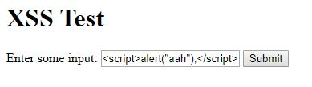
XSS Example

Slide 15
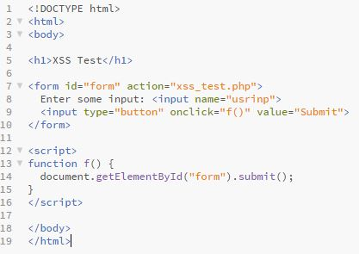
XSS Example
Normal input
  <input name = “Jackie”>
Input with XSS
  <input name = “<script>alert(“ahh”);</script>”

Slide 16
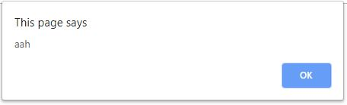
XSS Example

Slide 17
Why is XSS actually dangerous?
You can do a lot more with Javascript than alert()
  Redirect a user to a fake website
  Place an iframe around the site to track user input
  Read/Write browser cookies
  Exfil data over network requests

Slide 18

Prevention
Sanitize your user input to prevent input being interpreted as HTML.
Be careful about places that deal with user input
  Escape characters that could cause harm
    ‘<’ and ‘>’ can be written as &lt; and &gt;
  Blacklist and whitelist relevant characters.
  Control CORS headers to prevent including malicious files from other domains
Hackers when the software doesn’t sanitize user input

Slide 19
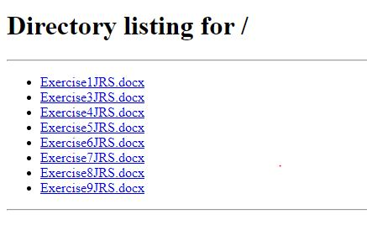
Directory Listing
It used to be common for servers to allow directory listing
This would allow you to list the directories on the server from the browser
Can specify the file path in the URL

Slide 20
Directory Traversal
You can all files in the intended directory, which is already dangerous, but in misconfigured servers you can also move up the directory tree by manipulating the URL
http://website.com/../../../../../../etc/passwd
http://website.com/../../../../../../etc/shadow
This can allow access to sensitive files on the server with no authentication

Slide 21
Command Injection
Can occur when user input is passed to the server and executed as a shell command on the host
$t = $_GET["target"];
echo "<pre>" . shell_exec("curl " . $t) . "</pre>";
What does this do?
Can we take advantage of it in some way?

Slide 22
Command Injection
Running additional commands:
  orig_cmd; cat /etc/shadow (always run 2nd cmd)
  orig_cmd && cat /etc/shadow (only if the first cmd succeeds)
  orig_cmd || cat /etc/shadow (only if the first cmd fails)
  orig_cmd | cat /etc/shadow (pipe orig_cmd output to second cmd)
Command Substitution:
  orig_cmd `cat /etc/shadow`
  orig_cmd $(cat /etc/shadow)
Prevent command injection by sanitizing inputs!

